Slide 1
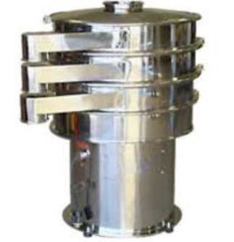
VIBRO SIFTER
Mfg.& Exp. Of Plants & Machineries for Pharmaceuticals,
Cosmetics, Chemicals food & Beverage Industries
Plot No. 1601/1,3rd Phase G.I.D.C., Vapi-396195. (Gujarat)
Email:sales@sidhipharmaequiment.com:sidhipharmaequipments@gmail.com:
Contact Person : Mr. Pravin Panchal (9924893790) Mr. Kiran Gophane (9545868896)
Website: www.sidhipharmaequipment.com

Slide 2
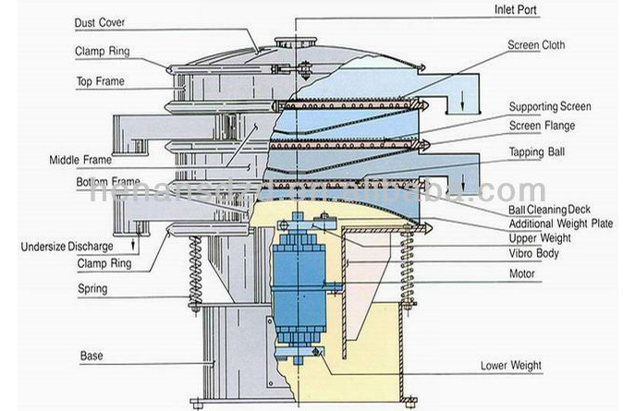
Vibro Sifter :
VIBRO SIFTER is used for screening, sieving, grading for solid-liquid separation, process to separate the desired elements and the undesired elements from the combination of solid to solid (where two solids are generally having different properties) and solid to liquid material. It used in various industries such as Pharmaceutical, Chemicals, Cosmetics, plastics, paints, plastic, minerals, rubber compounds, metal powders, detergents, pesticides and fertilizers, dyestuff and pigments
Vibro sifter consists of a screen placed on the base plate attached centrally to gyratory motor. The material fed through the inlet located on the top is dropped on the screen. The particles smaller than the mesh size passes from the screen and the larger sized particles are released through an outlet. The combination of vibratory motor and the weights placed on top and bottom of screen gives the desired filtration or separation of the material. Total assembly is mounted on suitable springs so that it becomes an independent body which vibrates without parting any vibrations to the foundations.

Slide 3
Silent Features :
Design is cGMP – Current Good Manufacturing Practices compliance.
All contact parts AISI 316 & non contact parts AISI 304.
Powerful vibration by gyratory motion by special Vibro motor.
Side outlet & fines discharge.
Easy movable & clean.
Noiseless operation.
Lead free and Silicon seal sieve.
Advantageous\ Benefits :
Robust Construction (Sifter is Made with high quality stainless steel and smooth finish)
High Power vibratory motor ( High vibration of vibro sifter comes from the heart of the sifter )
Lead Angle ( Change the lead angle as per the desired sieving requirements)
Easy Mesh Changing ( Vibro separator comes with easy mesh changing clamps which enables he operator to work smoothly)

Slide 4
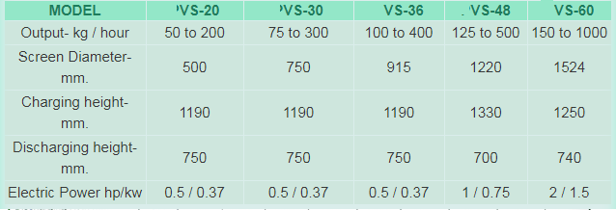
Technical Specification :
Single Source Provider for all your technical requirements.
One of the most important “Siddhi Pharma Equipment” guideline is to be closest to our Customers. We strive to create end-to-end solutions that meet our clients needs and their expectation.
Application :
Pharmaceutical
Food
Chemical
Cosmetics
Allied Industry

